Slide 1

T
CUAI cs231n 스터디
2024.05.21
발표자 : 김소원

Slide 2
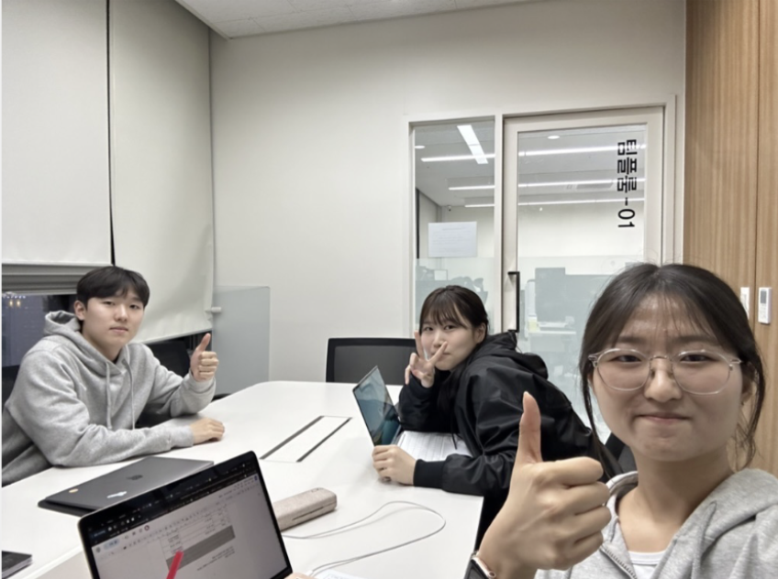
스터디원 소개 및 만남 인증
스터디원 1 : 김소원
스터디원 2 : 배현규
스터디원 3 : 임현오
스터디원 4 : 조다영

Slide 3
cs231n 과정
Lecture1Course Introduction
Lecture2 Image Classification
Lecture3 Loss Functions and Optimization
Lecture4 Introduction to Neural Networks
Lecture5 Convolutional Neural Networks
Lecture6 Training Neural Networks, part I
Lecture7 Training Neural Networks, part II
Lecture8 Deep Learning Software
Lecture9 CNN Architectures
Lecture10 Recurrent Neural Networks

Slide 4
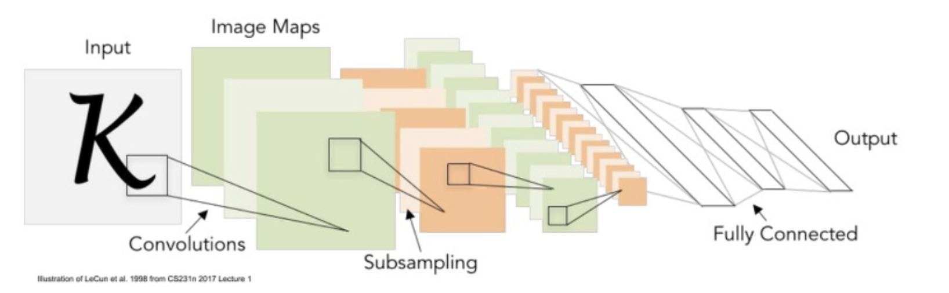
Convolution Neural Network

Slide 5
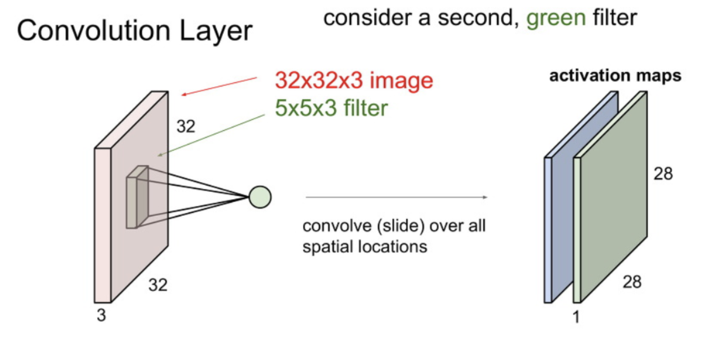
Convolution Neural Network
Notes:
Stride
Pad
Filter size (Width and Height)
Output channel (Number of filter)

Slide 6
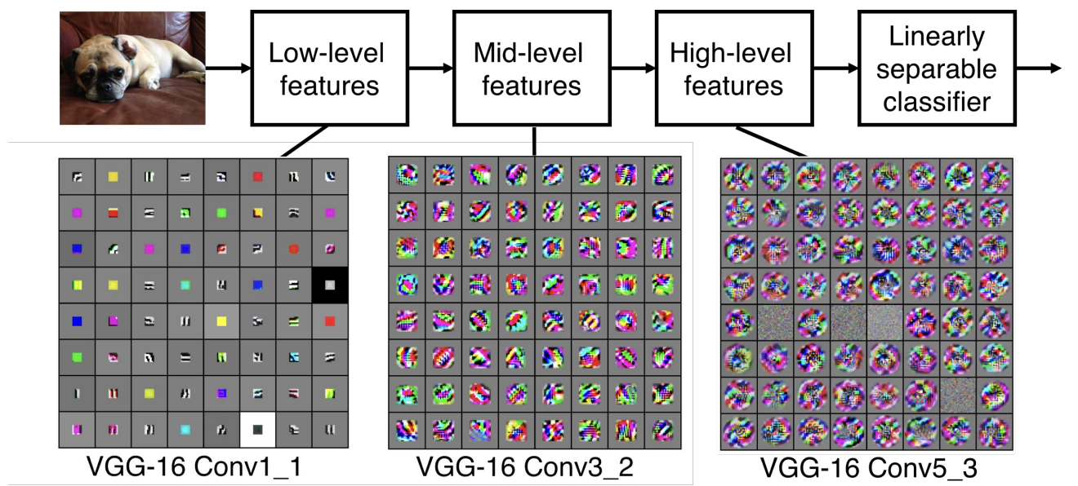
Convolution Neural Network

Slide 7
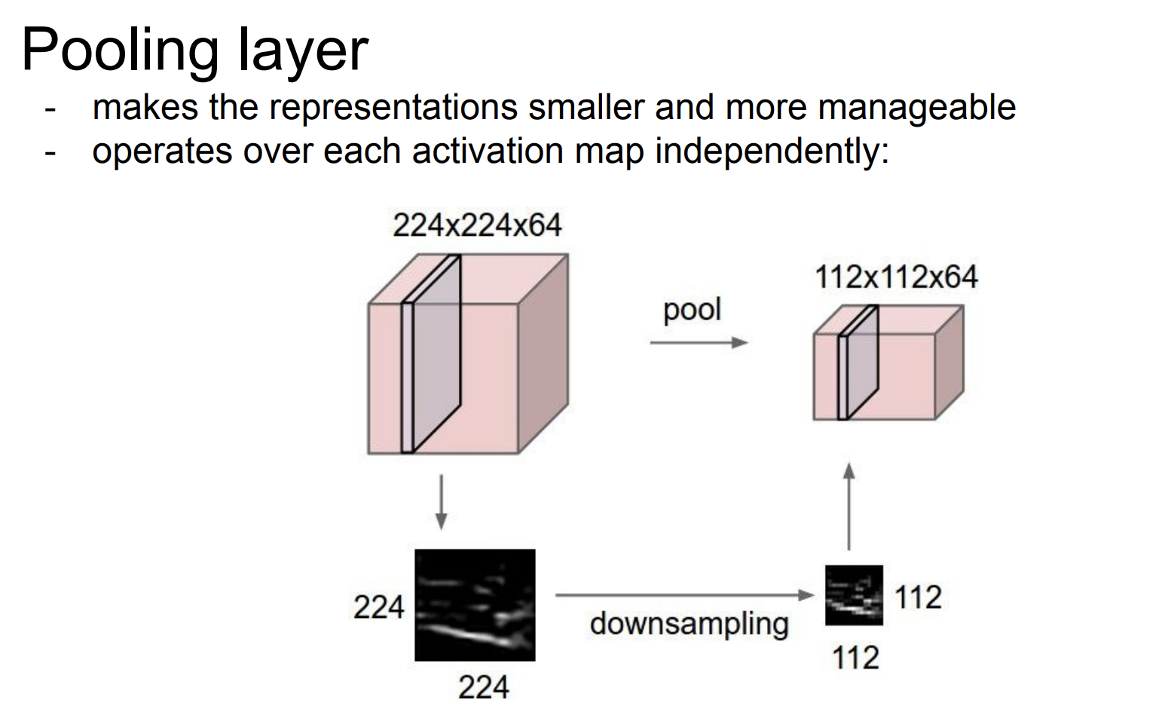
Convolution Neural Network

Slide 8
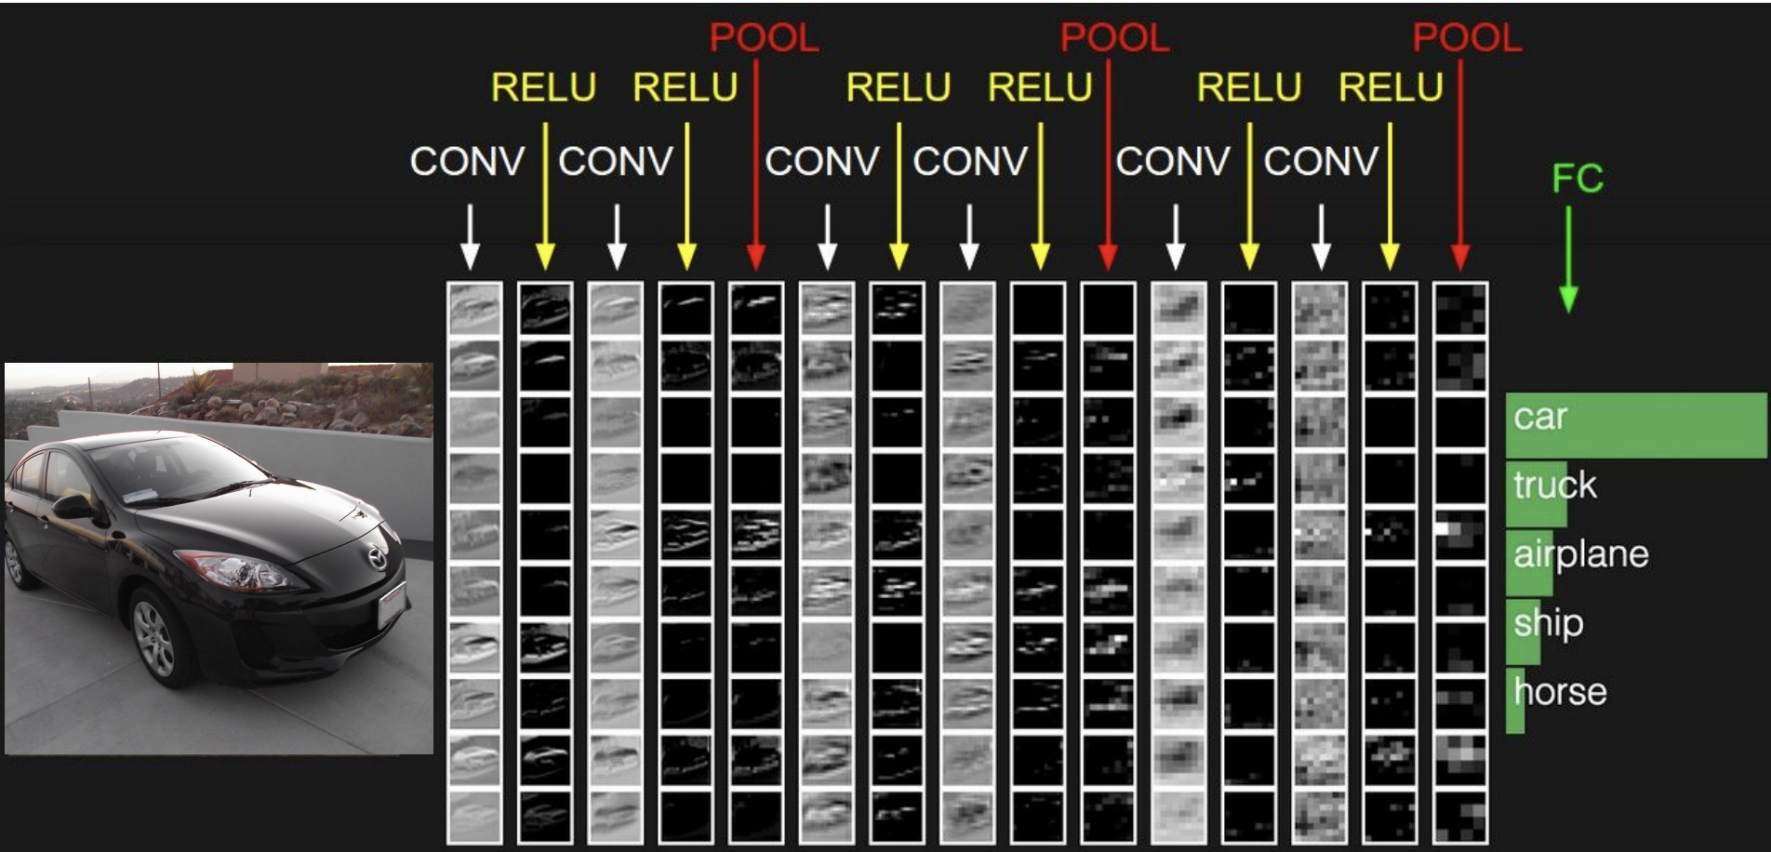
Convolution Neural Network

Slide 9
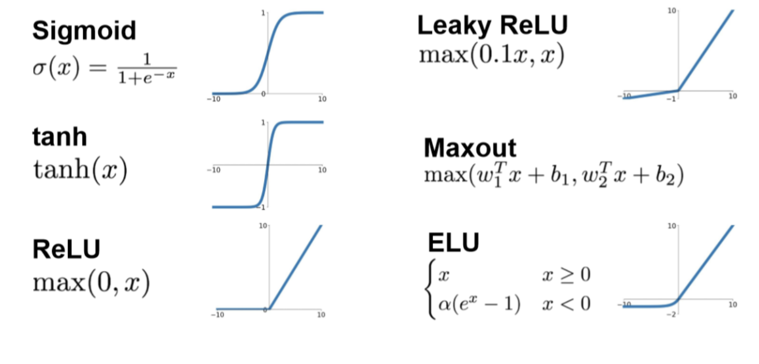
Activation Functions
Notes:
Optimization과 Regularization

Slide 10
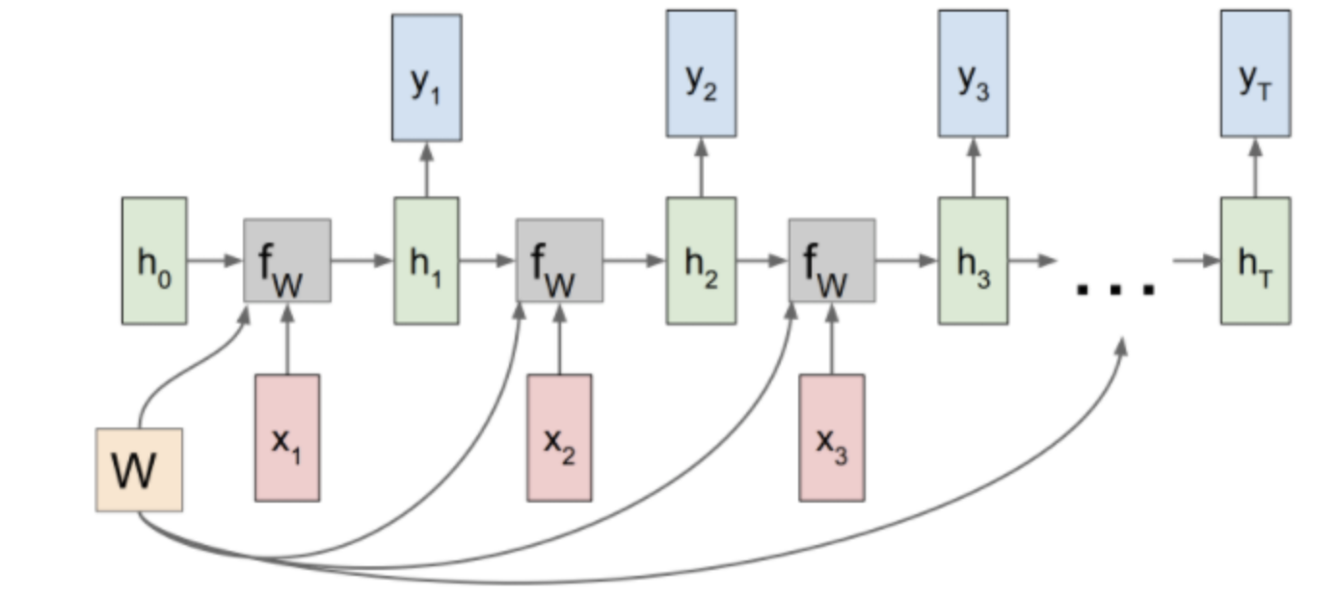
Recurrent Neural Networks
Notes:
Optimization과 Regularization

